Slide 1

Mobile Application Development, Fall 2021 Reusable Components

Slide 2
Today’s Agenda
Today’s Goals
Parents, Children, and Reusable Components
Intro to Images in JSX
A Final Challenge

Slide 3
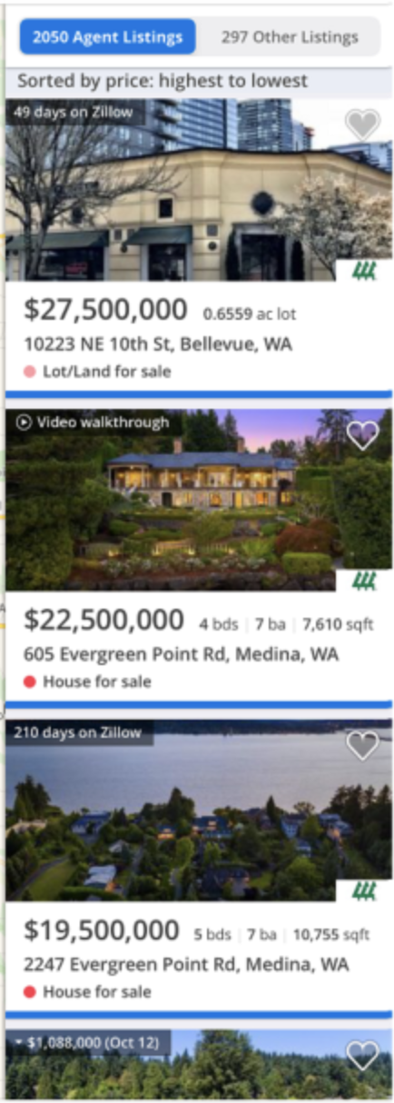
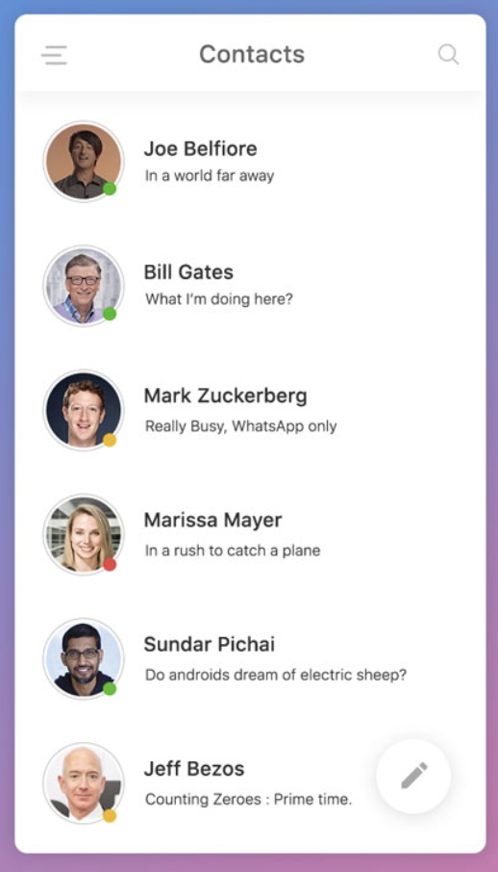
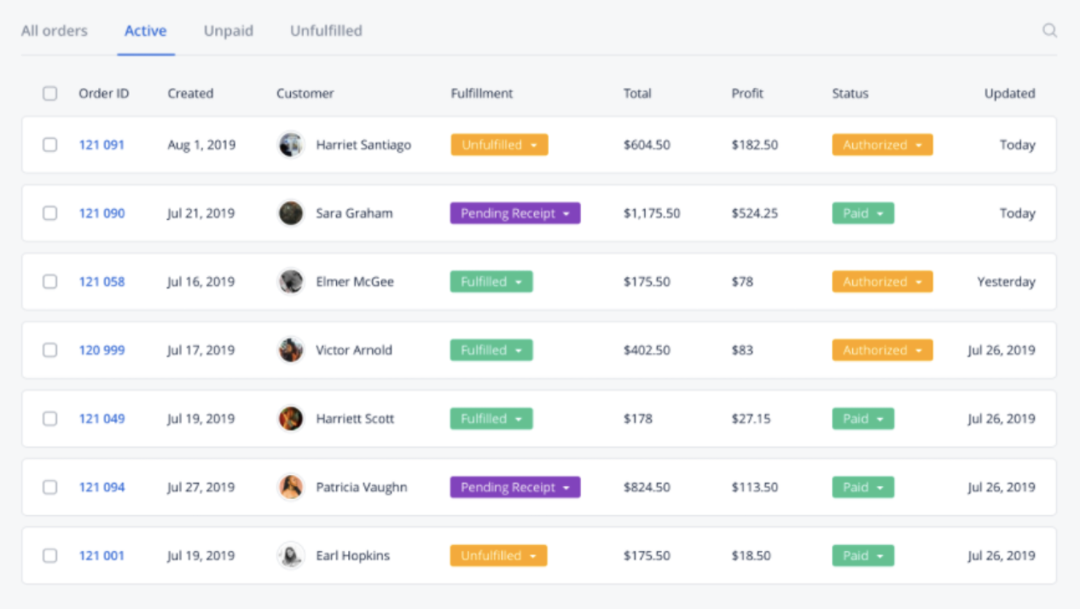
Today’s Goals
So, earlier we talked a little bit about how Lists were a pretty fundamental part of lots of apps!
And how these lists can take lots of different sizes and shapes.

Slide 4
Today’s Goals
If we take one of these lists, say, the contact list…
We can identify the pattern here pretty easily, yeah?

Slide 5
Today’s Goals
It’s “the same thing” presented 6 times!
First for Joe…
‘Then for Bill…
Then for Mark…
Etc. etc.

Slide 6

Today’s Goals
So far, all of the components that we’ve made thus far have been entire screens!
But they don’t have to be! Components can be “parts” of screens, too.
This here, could be an example of a component.

Slide 7



Today’s Goals
It has an Image element for their face…
And a text element for their name…
And another text element for their status.

Slide 8
Today’s Goals
That’s a pretty useful template!
It would be great if we could define a component of our very own in this abstract way, yeah?
With an image, a name, and a status.
Image
Name
Status

Slide 9




Today’s Goals
And then reuse that component many times, giving it different data each time!
That’s the name of today’s lecture!
Image
Name
Status

Slide 10


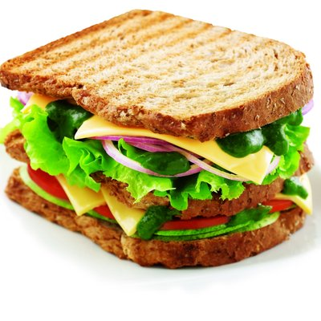
Today’s Goals
Coffee
For starters, we’re going to create something even simpler than what we just saw!
Just an image with some text!
To make, for example, the world’s simplest coffee shop menu.
Image
Doughnut
Text
Sandwich

Slide 11
Today’s Goals
This is going to be our own custom component! We’re going to call this component ImageDetail
But unlike Text, or Button, or TouchableOpacity, or FlatList…
ImageDetail is something that *we* are defining. We could call it anything we wanted!
Quick pop quiz: how do you think we are going to customize this single component to display all of our different menu items?
Image
Text

Slide 12
Today’s Goals
ImageScreen
With props!
So, we’ll have a screen to display our menu on, say, ImageScreen.
It will be responsible for displaying our three ImageDetail components that make up the menu
As well as passing along the requisite data via props.
{title: “coffee”,
image: cof.jpg”}
{title: “doughnut”,
image: d.jpg”}
{title: “sandwich”,
image: s.jpg”}
ImageDetail
ImageDetail
ImageDetail

Slide 13
Today’s Goals
ImageScreen
So this is great! We’re going to learn a lot about making our own custom components!
And learn even more about configuring them with our own custom props!
Let’s dig in!
{title: “coffee”,
image: cof.jpg”}
{title: “doughnut”,
image: d.jpg”}
{title: “sandwich”,
image: s.jpg”}
ImageDetail
ImageDetail
ImageDetail

Slide 14
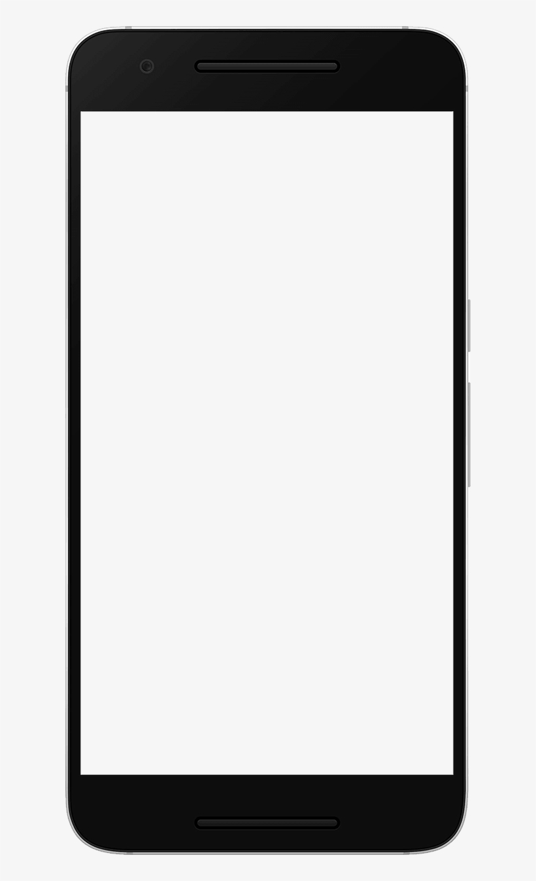
Today’s Goals
So, again, let’s say we want this stuff we’re learning today to go on the “ImageScreen”
And let’s say we want to be able to access ImageScreen from the same list that we were working on from before.
What are some plumbing things we need to do to achieve this?
ComponentsScreen
Coffee
ListScreen
Doughnut
Image Screen
Sandwich

Slide 15
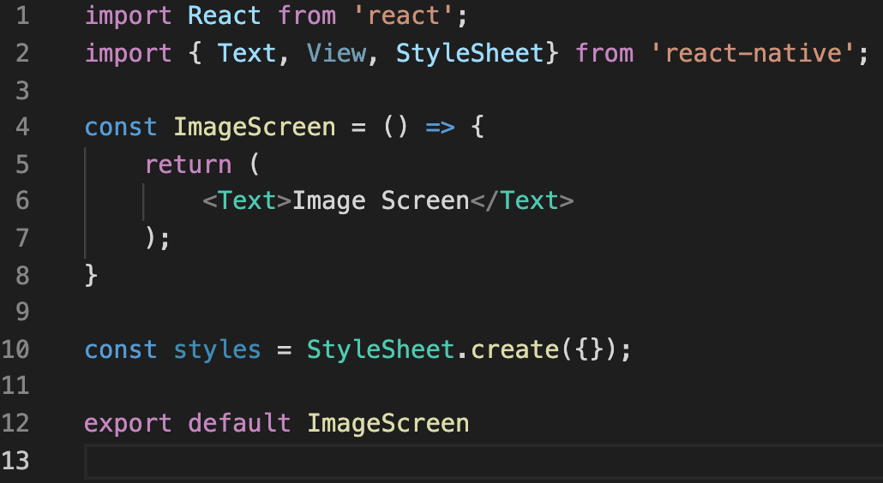
Today’s Goals
We need a new file for our ImageScreen!
We can call it ImageScreen.js, have it live in the same screens folder as everything else, and give it the same boilerplate code we’ve seen a bunch by now!

Slide 16
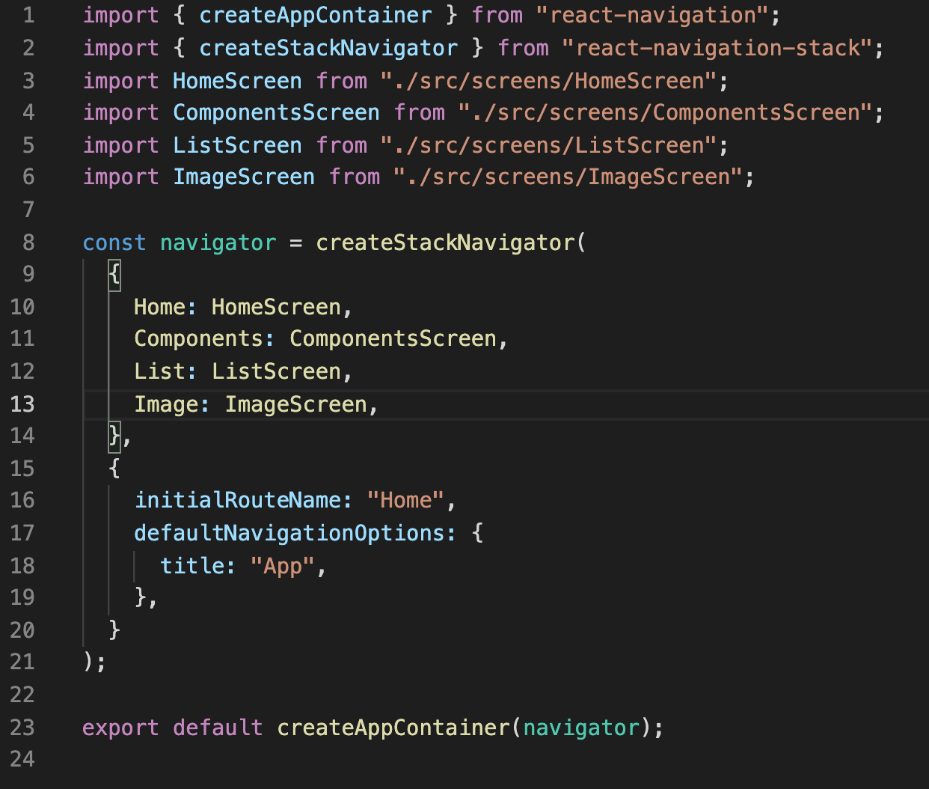
Today’s Goals
We need to update App.js
We need to import the ImageScreen we just exported, and hook it up to our Stack Navigator.

Slide 17
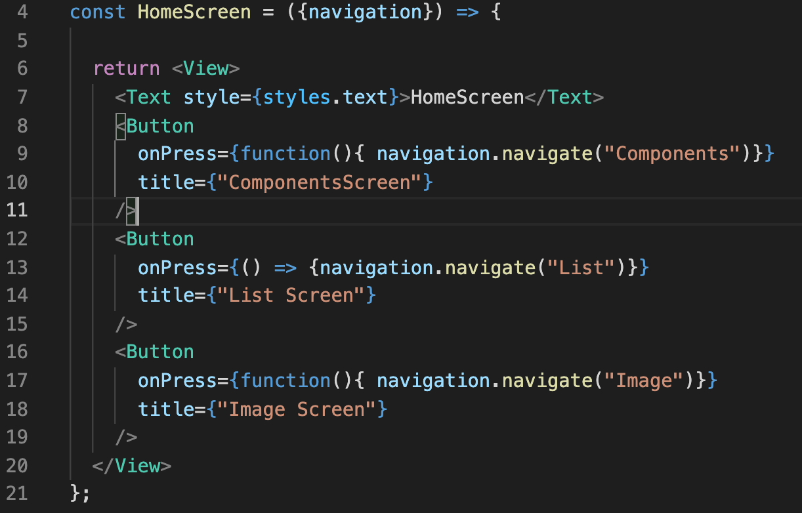
Today’s Goals
And we need to update our HomeScreen to add a button to reach the ImageScreen to it!
Note that I converted the previous “TouchableOpacity” to become a button for now, just for consistency.

Slide 18
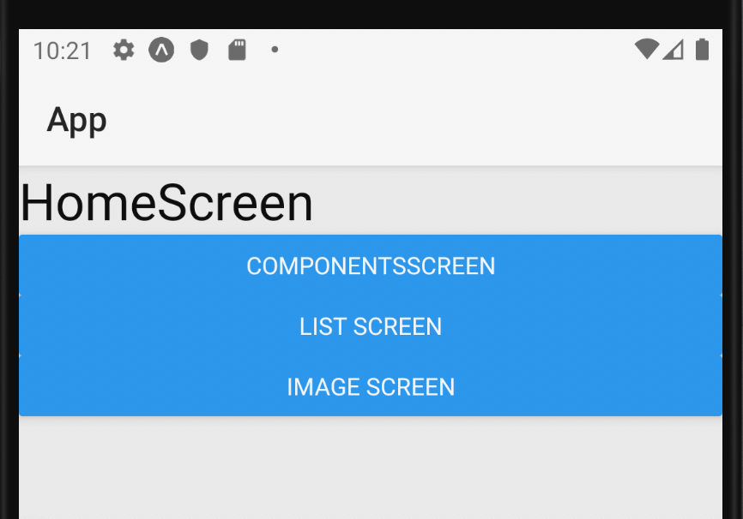
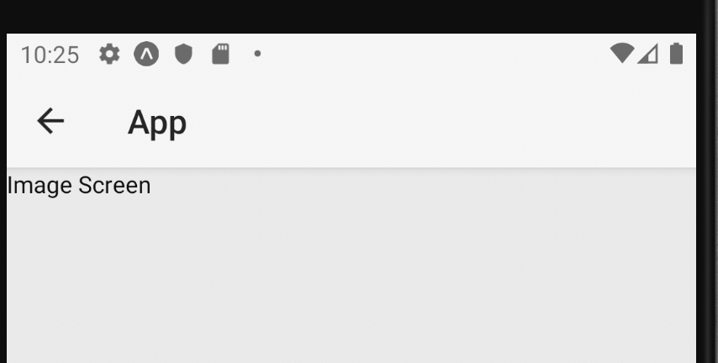

Today’s Goals
With that plumbing done, we should have something that works like this!

Slide 19
Today’s Goals
That’s fine and dandy and all, but we still have a ways to go before it’s displaying our lovely café menu!

Slide 20
Today’s Agenda
Today’s Goals
Parents, Children, and Reusable Components
Intro to Images in JSX
A Final Challenge

Slide 21
Parents, Children, and Reusable Components
ImageScreen
So, yes, our goal is something like this.
A single screen (called ImageScreen) that has three ImageDetail components.
And ImageDetail being an image and some text.
{title: “coffee”,
image: cof.jpg”}
{title: “doughnut”,
image: d.jpg”}
{title: “sandwich”,
image: s.jpg”}
ImageDetail
ImageDetail
ImageDetail
Coffee

Slide 22
Parents, Children, and Reusable Components
ImageScreen
One thing you might find confusing:
Screens are components!
But ImageDetail is also a component!
Remember: basically anything that you see is a component!
{title: “coffee”,
image: cof.jpg”}
{title: “doughnut”,
image: d.jpg”}
{title: “sandwich”,
image: s.jpg”}
ImageDetail
ImageDetail
ImageDetail
Coffee

Slide 23
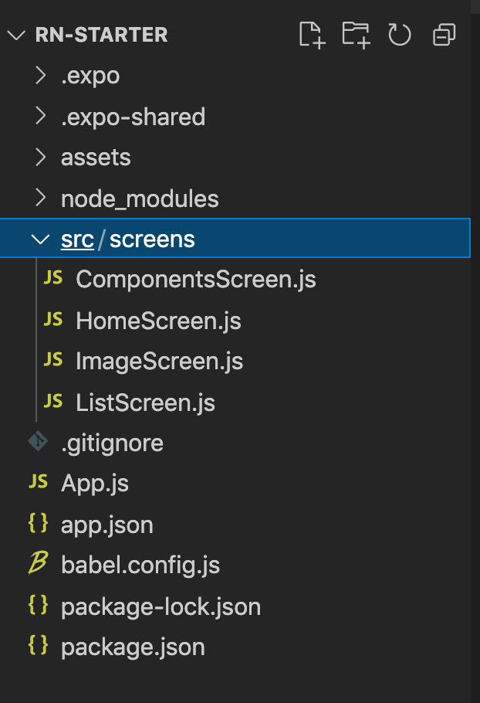

Parents, Children, and Reusable Components
So far, every component we’ve made thus far has been a screen.
And we’ve been making all of our new screens inside of the src/screens directory.
But perhaps we should keep our reusable components someplace else!

Slide 24
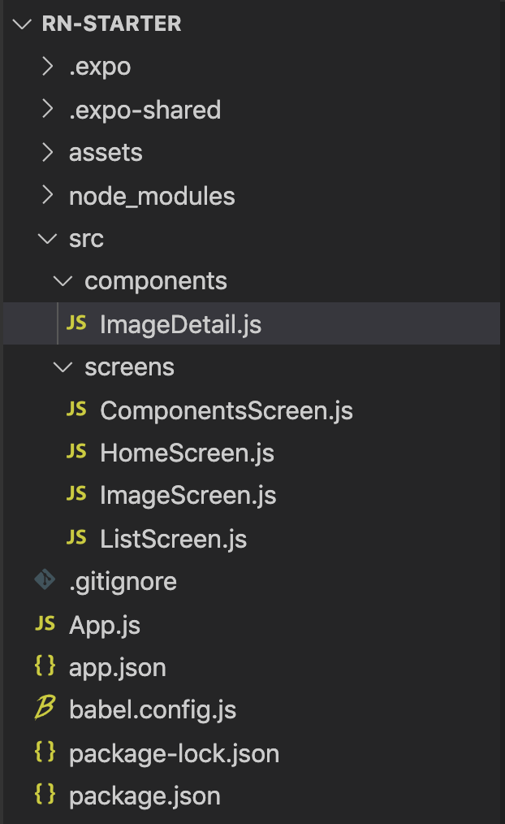



Parents, Children, and Reusable Components
You can call your directory something different if you wish, but I’m calling mine components
And then creating a new .js file called ImageDetail
Which we will write together!
Note that the screens directory is unchanged.

Slide 25
Parents, Children, and Reusable Components
So, I know we said we’d write it together…
But do you have any ideas as to how we might start that ImageDetail component?
What should go in there as a starting place?

Slide 26
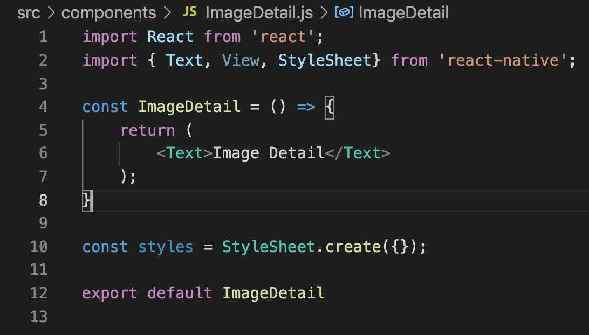
Parents, Children, and Reusable Components
That same ol’ boilerplate code we’ve been using for our screens!
You could even just copy and paste what we made for the ImageScreen component!
Just make sure to update the variable you are exporting!

Slide 27
Parents, Children, and Reusable Components
ImageScreen
So, exciting! Our ImageDetail component isn’t DONE yet, but it *exists*!
And now that it exists, we can discuss: just how do you display a component inside of another screen?
How do we show one component inside of another?
{title: “coffee”,
image: cof.jpg”}
{title: “doughnut”,
image: d.jpg”}
{title: “sandwich”,
image: s.jpg”}
ImageDetail
ImageDetail
ImageDetail

Slide 28
Parents, Children, and Reusable Components
ImageScreen
To show one component inside of another, you first need to go to the parent component.
Here, that would be ImageScreen – it is the parent because it is going to contain the ImageDetail components.
parent
{title: “coffee”,
image: cof.jpg”}
{title: “doughnut”,
image: d.jpg”}
{title: “sandwich”,
image: s.jpg”}
ImageDetail
ImageDetail
ImageDetail
child
child
child

Slide 29
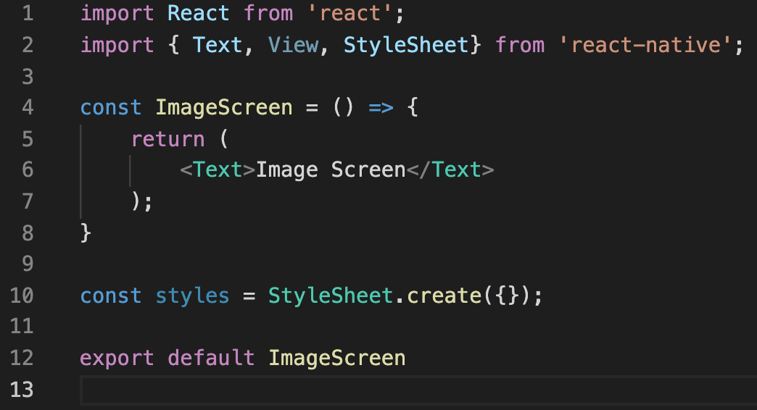
Parents, Children, and Reusable Components
So here we are, inside of ImageScreen.js
We want to make use of ImageDetail…
What is probably the first thing we need to do here?

Slide 30
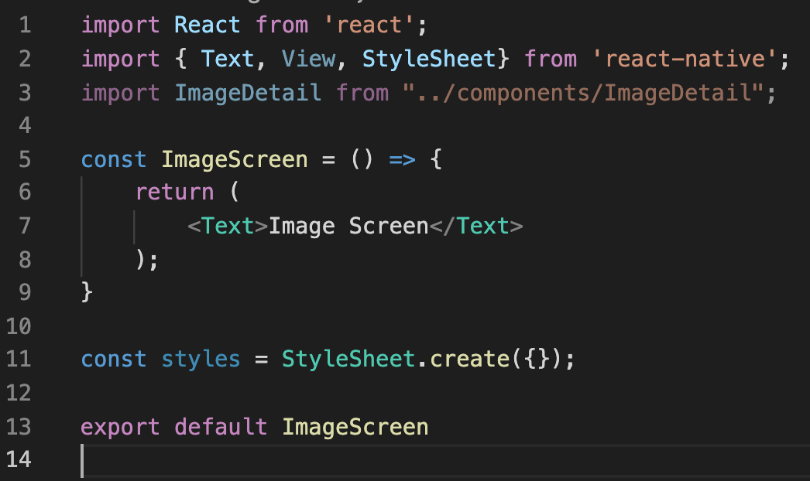

Parents, Children, and Reusable Components
We want to import it!
Note the use of “..” in the path to ImageDetail, that means “go up one directory from my current location”.

Slide 31
Parents, Children, and Reusable Components
So, ImageScreen.js is in the screens directory.
The “..” moves us up one level, into the “src” directory.
The “/components” moves us into the components directory.
Which is where “ImageDetail.js” is located!
ImageScreen.js

Slide 32
Parents, Children, and Reusable Components
So great, we’ve imported the child into the parent!
And now, let’s just use it!
Let’s use it the exact same way we’ve been using primitive react native elements!
ImageScreen.js

Slide 33
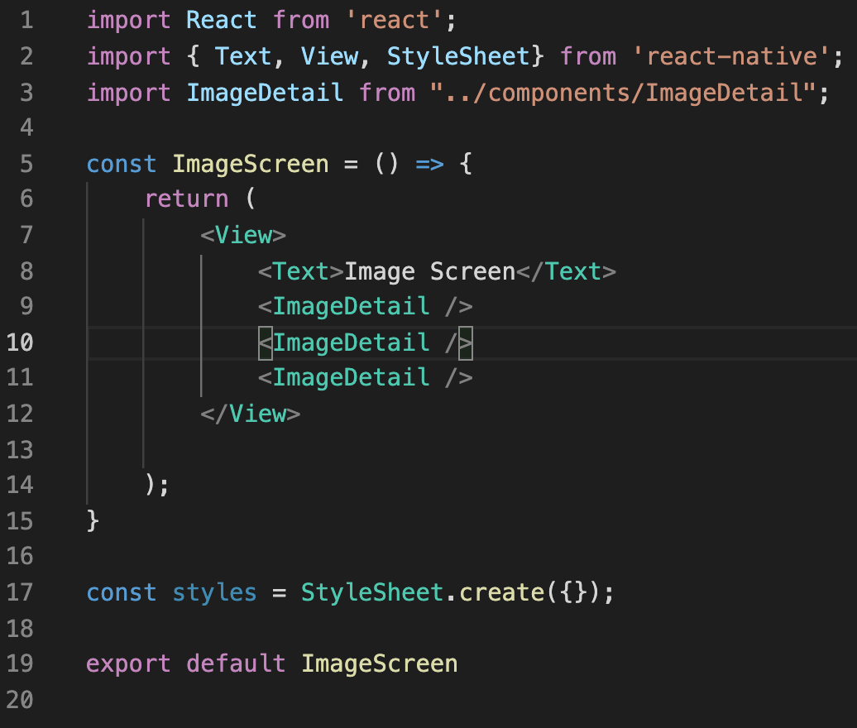


Parents, Children, and Reusable Components
Check it out!
We’re returning a single root element, a View, as before,
But now the View is full of our own custom components!
ImageScreen.js

Slide 34
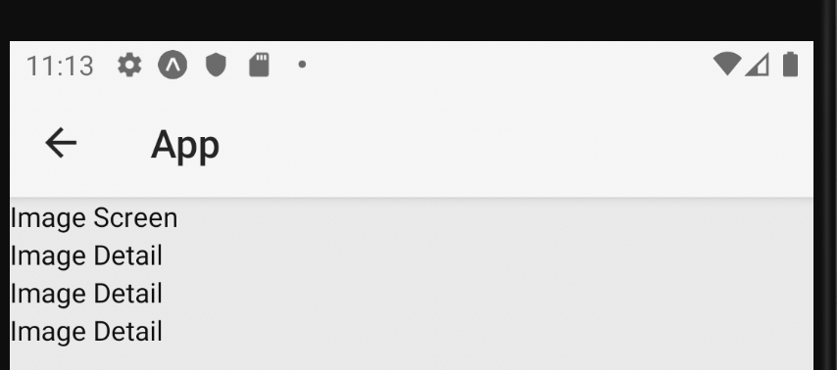
Parents, Children, and Reusable Components
And that is basically all you need!
If you were to run this, you would see a Text element, followed by three ImageDetail elements!

Slide 35
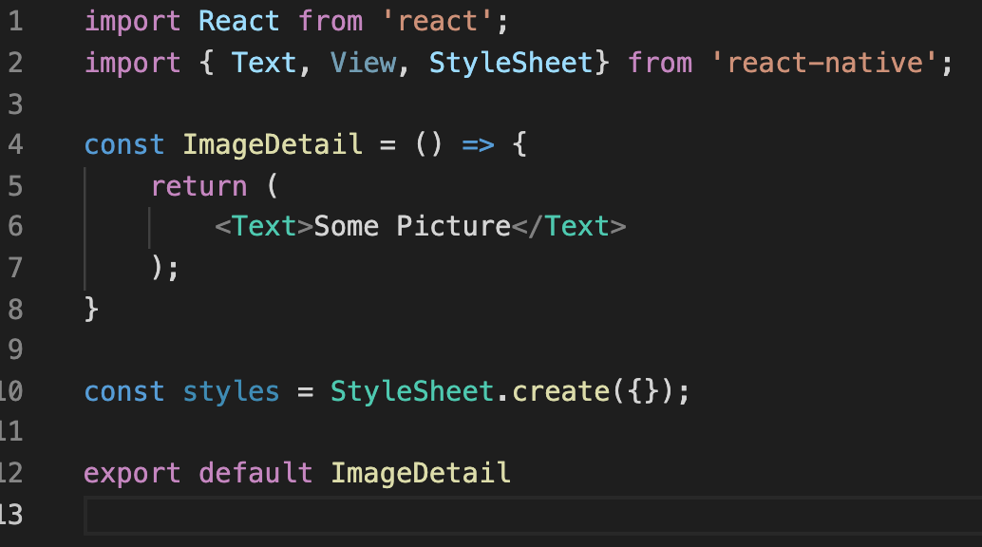
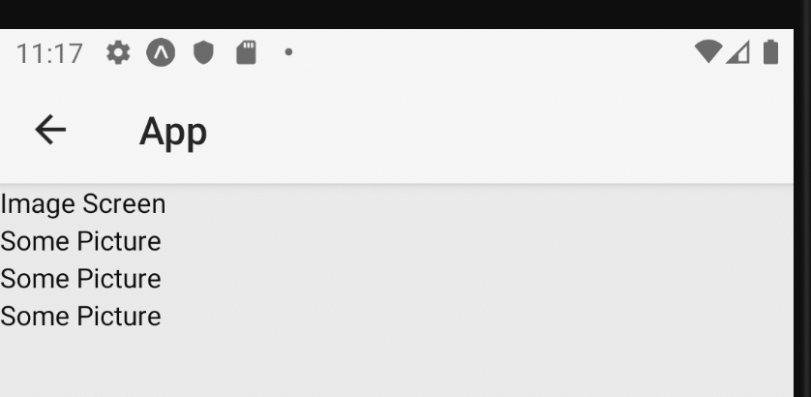

Parents, Children, and Reusable Components
It’s getting the text of Image Detail FROM ImageDetail.js.
If we edited that file, we’d see it reflected in the output!
ImageDetail.js

Slide 36
Parents, Children, and Reusable Components
ImageScreen
OK, one step closer! We are definitely displaying three ImageDetail components now!
But all of them are the same, and changing the file changes ALL instances of it.
We need those configuration props!
parent
{title: “coffee”,
image: cof.jpg”}
{title: “doughnut”,
image: d.jpg”}
{title: “sandwich”,
image: s.jpg”}
ImageDetail
ImageDetail
ImageDetail
child
child
child

Slide 37
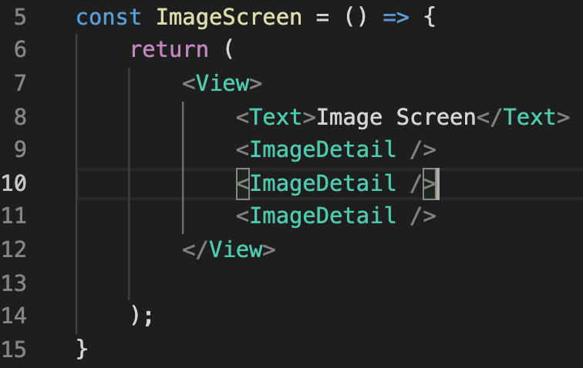
Parents, Children, and Reusable Components
And as it turns out, adding those configuration props is surprisingly simple!
We basically just make up whatever we want.
We recall, we want our ImageDetail to have both text and an image. Let’s start with the text…
ImageScreen.js
Coffee

Slide 38
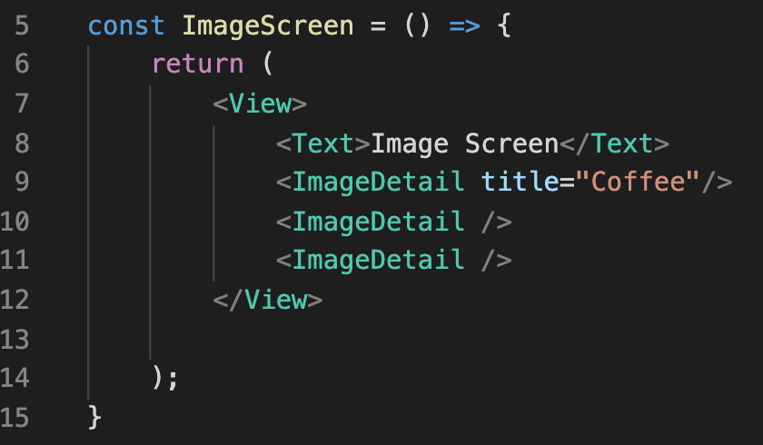
Parents, Children, and Reusable Components
We just invented a new prop for one of our ImageDetail components!
We called it title, but we could have called it anything we wanted!
We’re defining this! We get to decide!
ImageScreen.js
Coffee

Slide 39
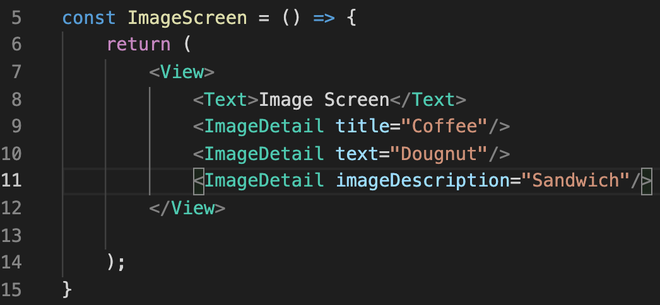
Parents, Children, and Reusable Components
We could go really crazy with this, and give each ImageDetail component a different prop even!
This is probably not a great idea though. Why?
Because our ImageDetail has one text element. Even though its contents will change, the name of the prop itself should remain consistent.
ImageScreen.js
Coffee

Slide 40
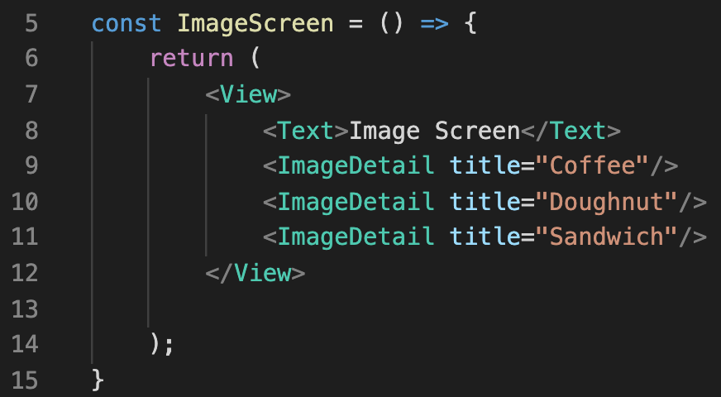
Parents, Children, and Reusable Components
So yes, we can call the prop anything, but it should be consistent across our ImageDetail components.
Let’s just go with title for now.
ImageScreen.js
Coffee

Slide 41
Parents, Children, and Reusable Components
OK! So, we are now “sending” a title prop to each of our ImageDetails, but we need to complete the handshake!
Our ImageDetail component needs to *do* something with this prop!
ImageScreen.js
Coffee

Slide 42
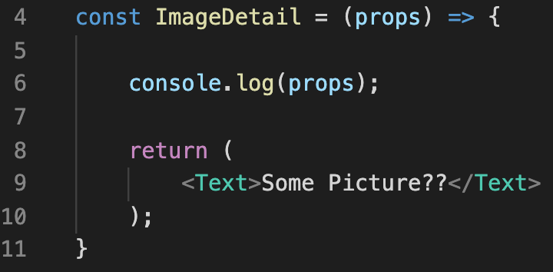

Parents, Children, and Reusable Components
Similar to when we received the props from React Navigation!
We just add a props parameter into the parameter list of the function that returns JSX!
Let’s try printing it out and see what we get… any guesses?
ImageDetail.js

Slide 43
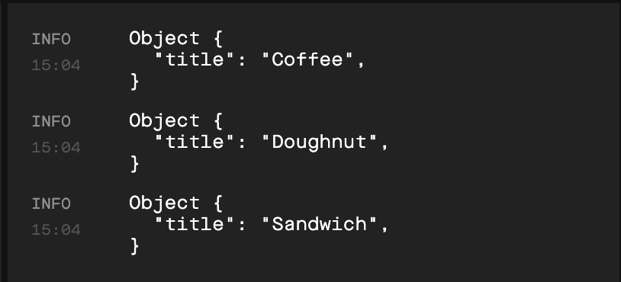
Parents, Children, and Reusable Components
We’ll end up seeing three console messages total!
One for each ImageDetail we are rendering
Each message is printing out an Object
i.e., the props object on line 6 of ImageDetail.js
And that Object has one property
Whose name is “title” and whose value is, ~*ta da*~ the value we passed in to the prop!
ImageDetail.js
Console Output

Slide 44
Parents, Children, and Reusable Components
And with that, we’ve completed the loop!
We can both send data to our custom component!
And then access it from within the component!
How would we change ImageDetail.js so that instead of “Some Picture??” it prints out the menu item?
ImageDetail.js
Console Output

Slide 45
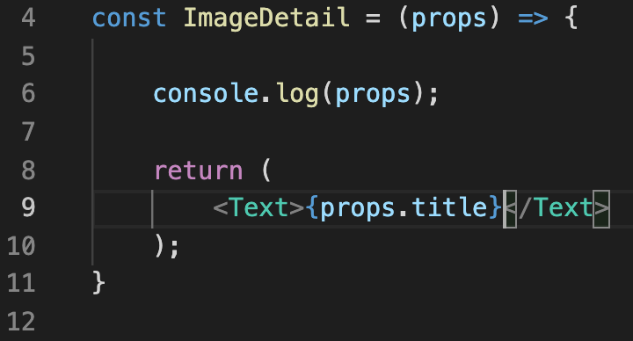

Parents, Children, and Reusable Components
Maybe a little something like this!
We know that each prop object has a title property that corresponds to the menu item!
We can access that with props.title
And when we want to access object properties in JSX, we need to enclose them in { and }
ImageDetail.js

Slide 46
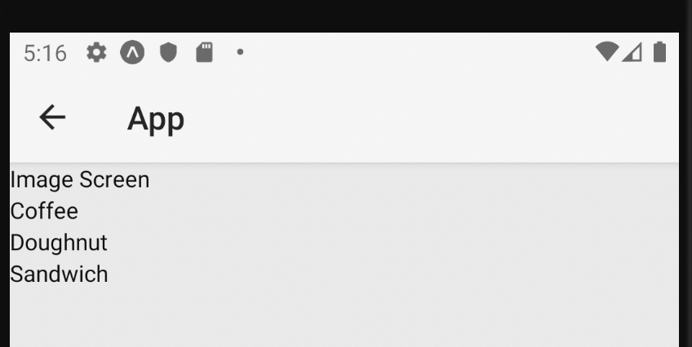
Parents, Children, and Reusable Components
And indeed, you’ll find that your app now looks something like this!
Great! We’ve got the detail part down, but we’re missing the Image of our ImageDetail
Let’s address that now!

Slide 47
Today’s Agenda
Today’s Goals
Parents, Children, and Reusable Components
Intro to Images in JSX
A Final Challenge

Slide 48
Intro to Images in JSX
Images are, of course, a very important part of apps!
Some of you took the initiative to see how to make images for your very first assignment already!
For the rest of us: our image-less lives are officially ending!

Slide 49
Intro to Images in JSX
I’m going to be using the images here (which you are welcome to copy and paste yourselves from this slide).
But really, basically any images will do for now!

Slide 50
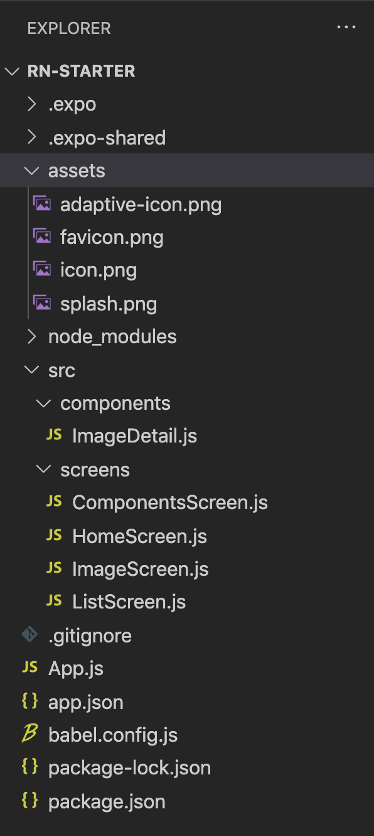


Intro to Images in JSX
In your rn-starter folder, you should see a folder called assets.
This should already have some images from your initial download of the project.
This is where you want static media to go.
i.e., files that aren’t going to be changing/being generated.
E.g., images!

Slide 51
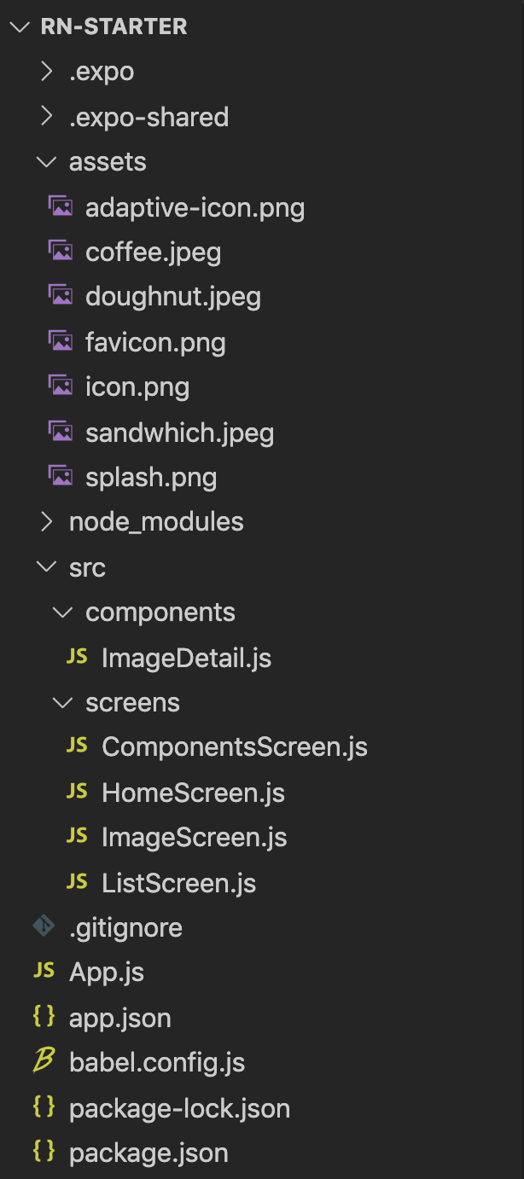
Intro to Images in JSX
So, for whatever images you want to add to your project, just add them to rn-starter/assets in the usual ways.
Downloading them there,
Dragging and dropping them there,
Using a mv command,
Etc. etc.

Slide 52
Intro to Images in JSX
Great, now we can start using them in our project! But how do we do it?
Any wild hunches as to some of the things we might need to do? Based on what we know about React Native thus far?

Slide 53
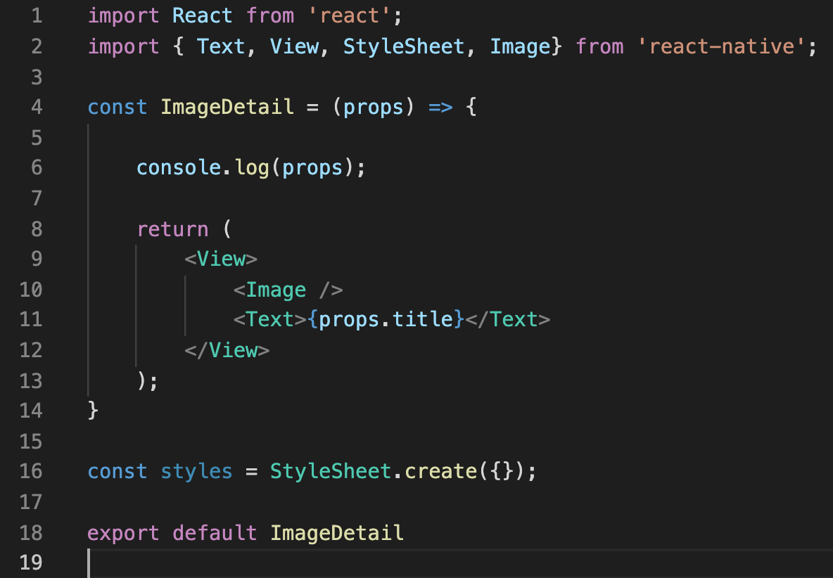
Intro to Images in JSX
My hope is that by this point, we could just “kinda guess” something up to this point.
We import something (here, Image)
And then we use it in our JSX!
ImageDetail.js

Slide 54

Intro to Images in JSX
We haven’t filled in the Image tag yet, but we can see that it is self closing!
Let’s fill it in now!
ImageDetail.js

Slide 55
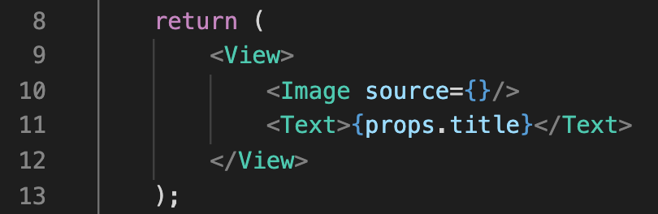
Intro to Images in JSX
The magic property we need for the image is source.
It specifies the location of the image file you want to display.
(Same idea, but different word from, the src property of img tags in HTML!)
ImageDetail.js

Slide 56
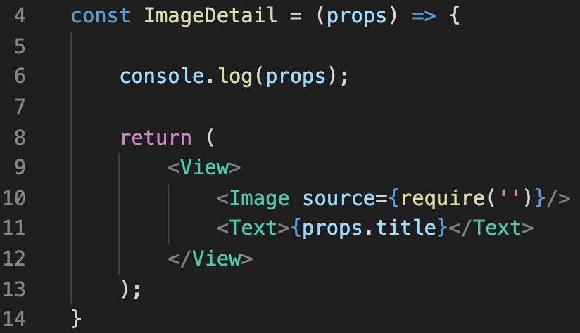
Intro to Images in JSX
And then what goes *inside* the source prop is actually a call to require.
This is traditionally a node thing. It is a way to load in modules, and to make sure you don’t use them in your code before they are loaded.
ImageDetail.js

Slide 57
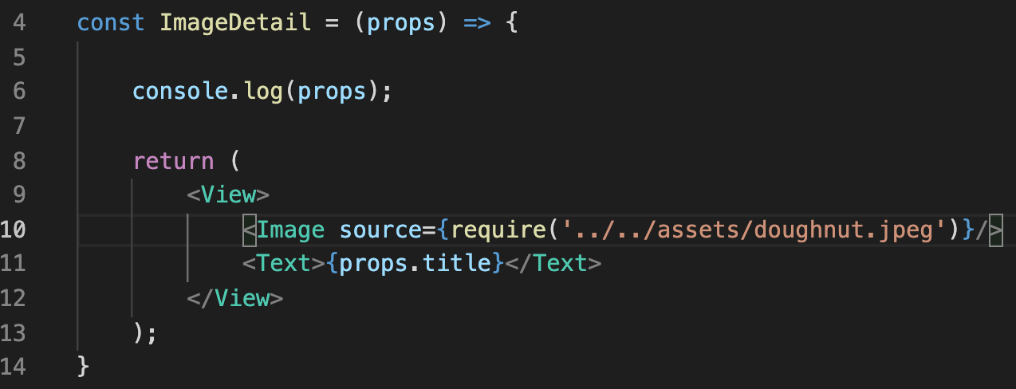
Intro to Images in JSX
And then finally, inside of THERE, we specify the relative path to our image file!
ImageDetail.js

Slide 58
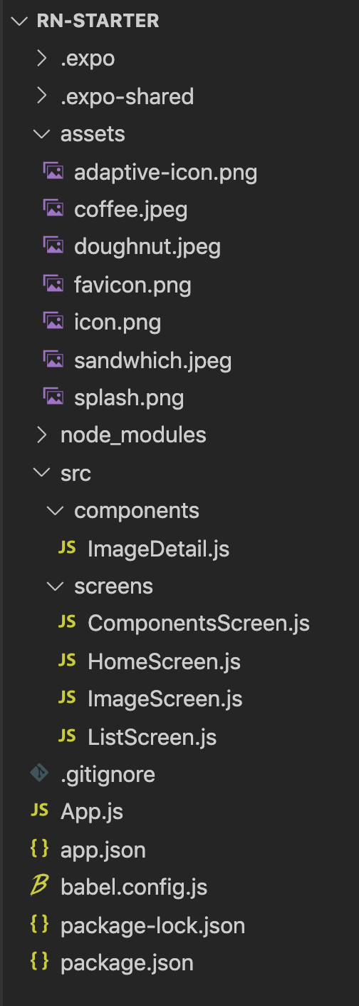
Intro to Images in JSX
ImageDetail.js
Remember, relative path means “relative to our current directory”
Our current directory (i.e., where ImageDetail.js is located) is:
rn-starter/src/components
The location of our image is:
rn-starter/assets/doughnut.jpeg
And “..” means “go up one directory”

Slide 59
Intro to Images in JSX
ImageDetail.js
Start: rn-starter/src/components Target: rn-starter/assets/doughnut.jpeg
Relative path: “../../assets/doughnut.jpeg”
So the first “..” would take us to: rn-starter/src
The second “..” takes us to: rn-starter
And then from rn-starter, we go inside of the assets directory.
Which is where doughnut.jpeg is located!

Slide 60
Intro to Images in JSX
ImageDetail.js
Not a problem for today, but something that might come up on your own:
The string you pass into the require call needs to be “complete”.
That is you can’t get away with things like in-line concatenation, e.g.:
require(‘../../assets/’ + myFileName + ‘.jpeg”); // this would not work!
More details here: https://reactnative.dev/docs/images

Slide 61
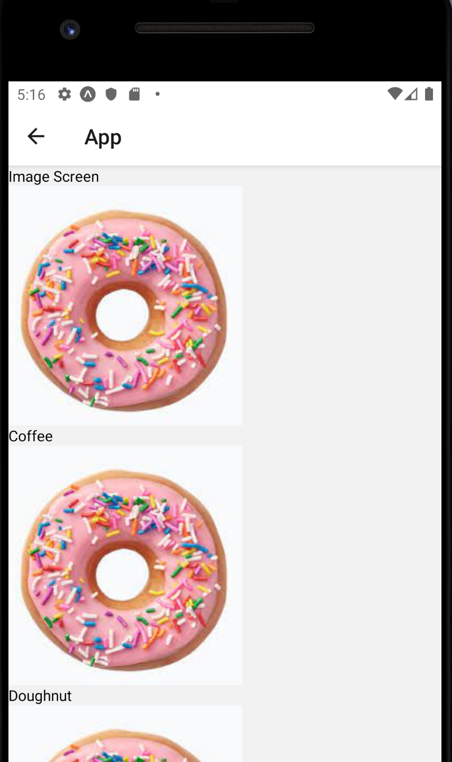
Intro to Images in JSX
ImageDetail.js
Anyway! Now that we have this, you’ll see that we are now successfully displaying images!
Note: displaying images from *outside* of our project is slightly different. More on that later!
The problem, of course, is that we just hard coded the doughnut image file.
So each ImageDetail component will display a doughnut!

Slide 62
Intro to Images in JSX
So, if I told you that you had everything that you needed to make each ImageDetail display a different image, would you believe me?
What do we need to change to have each ImageDetail display something different?
Hint: You need to update both ImageDetail.js and ImageScreen.js

Slide 63
Intro to Images in JSX
ImageScreen
We’re basically going to handle this just as we handled passing in the title! We’ll pass the image down as a prop!
And then use that new part of the prop object inside of ImageDetail
Which, truly, we’ve been threatening to do all lecture long!
{title: “coffee”,
image: cof.jpg”}
{title: “doughnut”,
image: d.jpg”}
{title: “sandwich”,
image: s.jpg”}
ImageDetail
ImageDetail
ImageDetail

Slide 64
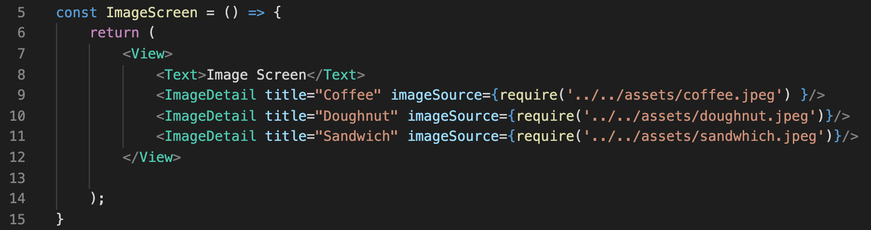
Intro to Images in JSX
ImageScreen.js
So back in ImageScreen, we’ll make a new prop for the image!
I’m calling mine “imageSource” but again, this is our own component, so we have the power to name it whatever we want!
And note that what we give to this new prop is the whole require statement, not just the path to the image
Ties in to what we alluded to earlier, about needing the complete string.

Slide 65
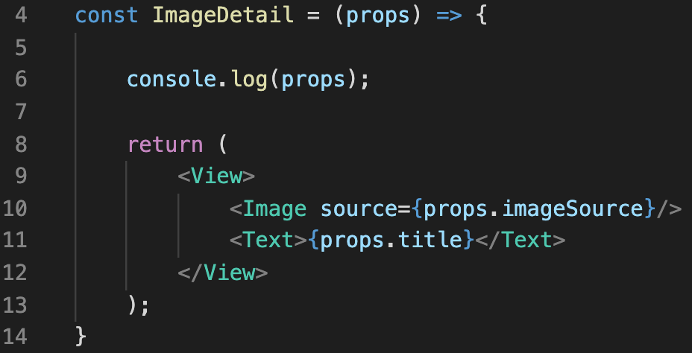

Intro to Images in JSX
And then in ImageDetail.js, we specify the new prop that we just defined as the source of our Image component!
Let’s take a quick look at what is getting printed out to the console now…
ImageScreen.js
ImageDetail.js

Slide 66
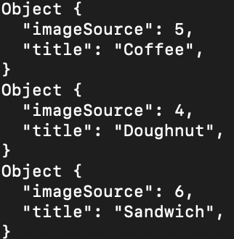

Intro to Images in JSX
If we look at the console output now, we’ll see that our props object has two properties now.
imageSource and title
Hopefully that makes sense and feels good!
But we can see that the value for imageSource are these numbers.
Might be surprising!
The require statement did work behind the scenes here.
Basically gave each image an id. This is fine!
ImageDetail.js
Console output

Slide 67
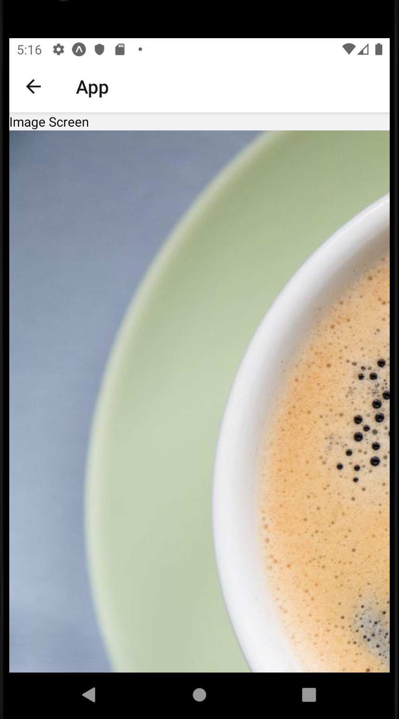
Intro to Images in JSX
However, something that is *not* fine is – if you used the images I provided you with – they are all different sizes!
And the coffee image is way too big!
Thankfully, we can leverage style sheets to help us out here!

Slide 68
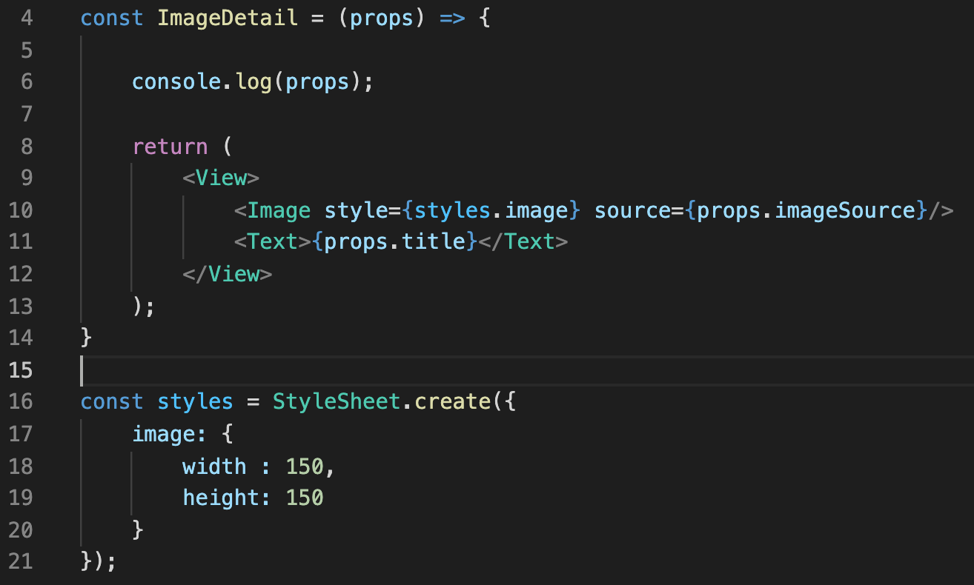



Intro to Images in JSX
So we can simply update our StyleSheet to have a new style that we’ll apply to images.
And then give that style two properties
width
height
And then apply that style to our Image component.
ImageDetail.js

Slide 69
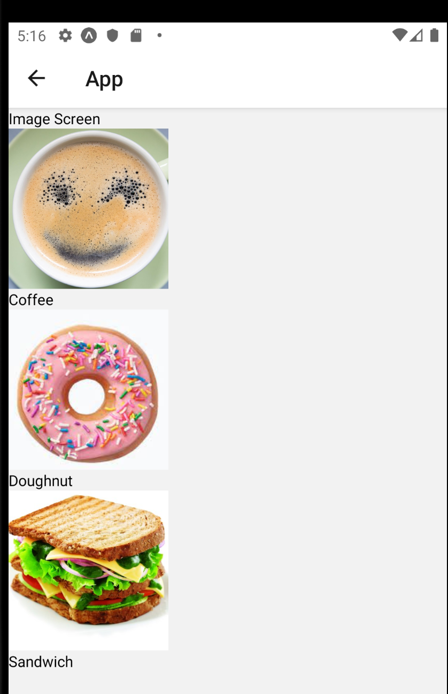
Intro to Images in JSX
And now it looks much more presentable!

Slide 70
Intro to Images in JSX
So again, this is a big deal! We’ve learned how to make our own custom components!
We’ve seen how we can include multiple copies of that component in other parts of our project!
And we’ve learned how we can use props to customize how each individual instance of that component appears!
We’re going to be doing this a lot throughout the semester!

Slide 71
Today’s Agenda
Today’s Goals
Parents, Children, and Reusable Components
Intro to Images in JSX
A Final Challenge

Slide 72
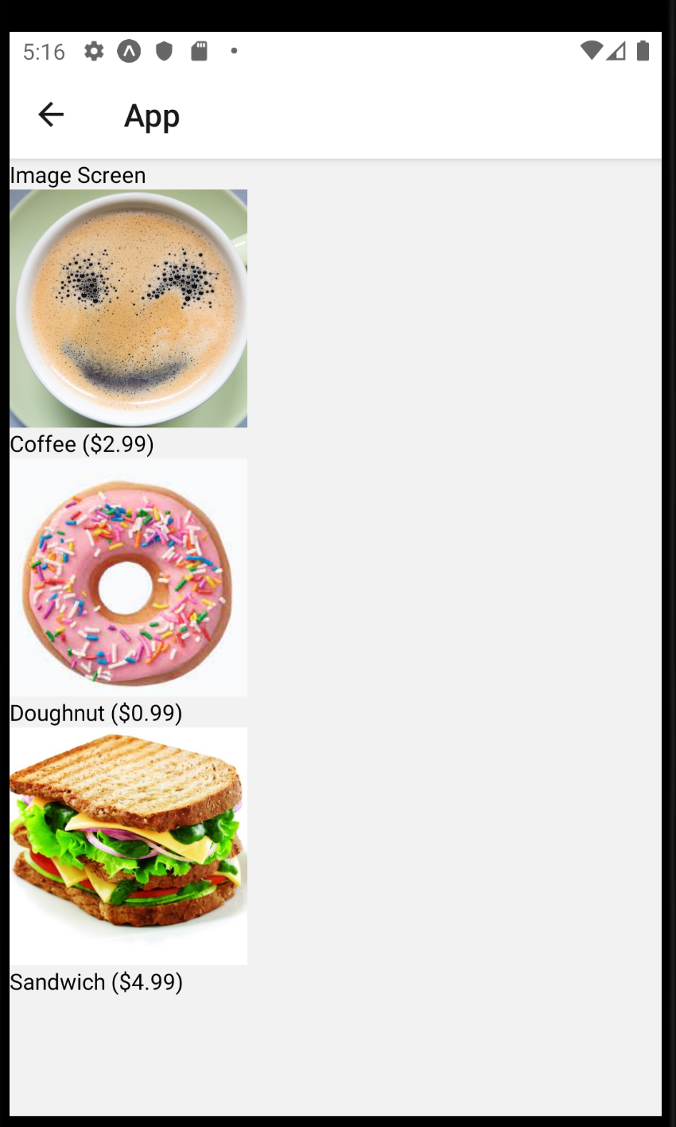
Final Challenge
Your Challenge:
Edit imageDetail so that is accepts some additional prop! And then display it!
This can be something as simple as giving each menu item a “price” that gets displayed.
Make sure you add your screen to the “app screenshots” channel on Discord!

